Slide 1
NextJs Installation
Course Code: CSC 4182
Course Title: Advanced Programming In Web Technologies
Dept. of Computer Science
Faculty of Science and Technology
Lecture No: | 1 | Week No: | 10 | Semester:
Lecturer: | Sazzad Hossain; sazzad@aiub.edu

Slide 2
Lecture Outline
Creating the first NextJS App
Running the App
Changing port address
Nextjs directory structure
Pages in Next.js
Create a New Page
Link Component
External Links
Image Component

Slide 3
Creating the first NextJS App
Ensure that Node.js is installed on your computer. You can download it from the official website: https://nodejs.org/en/download/
Open the terminal/command prompt and navigate to the directory where you want to create your Next.js project.
Run the following command to create a new Next.js project:
npx create-next-app@latest
√ What is your project named? ... nextjs14
√ Would you like to use TypeScript? ... No / Yes
√ Would you like to use ESLint? ... No / Yes
√ Would you like to use Tailwind CSS? ... No / Yes
√ Would you like to use `src/` directory? ... No / Yes
√ Would you like to use App Router? (recommended) ... No / Yes
√ Would you like to customize the default import alias (@/*)? ... No / Yes
**Nextjs 14 requires Nodejs v18.17.0

Slide 5
Running the App
Go to your project folder and execute following command;
npm run dev
Open the browser and write
http://localhost:3000

Slide 6
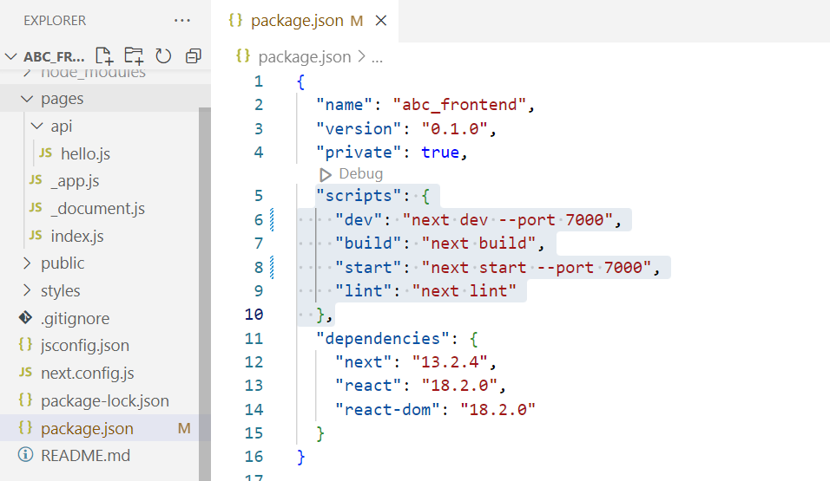
Changing port address
Open your Next.js project in your code editor or IDE.
Locate the package.json file in the root directory of your project.
Add the --port flag followed by the desired port number to the start script in the "scripts" section of the package.json file. For example, to set the port to 7000, the "start“ and “dev” script would look like this:

Slide 7
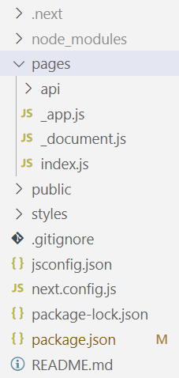
Nextjs directory structure
.next/: This is a hidden directory created by Next.js during the build process. It contains the compiled assets and server-side rendered pages of the application.
node_modules/: This is a directory that contains all the dependencies installed by npm for the project.
pages/: This directory contains Next.js pages that define the routes of your application.
api/: This directory contains API routes that can be called from the client or server.
public/: This directory contains static assets that are served directly to the client, such as images or fonts.
styles/: This directory contains global styles and CSS modules.
.gitignore: This file specifies which files and directories should be excluded from version control when using Git.
.prettierrc: This is the configuration file for Prettier, a code formatter that can automatically format your code to a consistent style.
next.config.js: This is the configuration file for Next.js. It allows you to customize various aspects of the Next.js build process and development environment.
package.json: This file contains metadata about the project, including its dependencies and scripts.

Slide 8
Pages in Next.js
In Next.js, a page is a React Component exported from a file in the pages directory.
Pages are associated with a route based on their file name. For example, in development:
pages/index.js is associated with the / route.
pages/posts/first-post.js is associated with the /posts/first-post route.

Slide 9
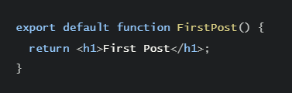
Create a New Page
Create the posts directory under pages.
Create a file called first-post.js inside the posts directory with the following content:
The component can have any name, but you must export it as a default export.
Now, make sure that the development server is running and visit http://localhost:3000/posts/first-post.

Slide 10
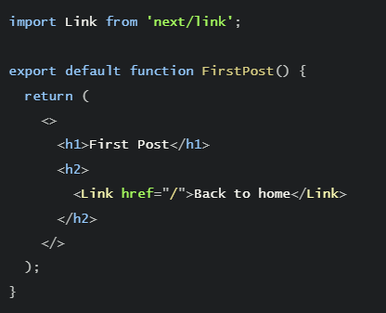
Link Component
In Next.js, Link Component next/link to link between pages in your application.
<Link> allows client-side navigation and accepts props that give you better control over the navigation behavior.

Slide 11
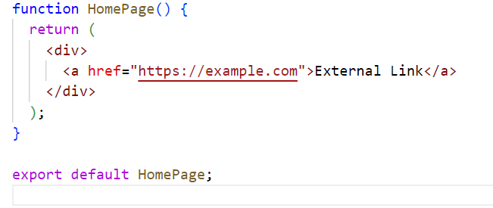
External Links
To create external links in Next.js, we can use a standard HTML anchor tag.

Slide 12

Image Component
The Next.js Image component, next/image, is an extension of the HTML <img> element
To add an image to your application, import the next/image component:

Slide 13
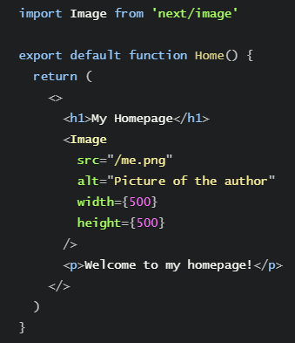
Image Component

Slide 14
References
W3Schools Online Web Tutorials, URL: http://www.w3schools.com
Next.js, URL: https://nextjs.org/
Mozilla Developer Networks, URL: https://developer.mozilla.org/

Slide 15
Thank You!

